Slide 1

Evaluation of Nawarddeken Academy
Being researchers and doing research on Bininj Country
Dean Yibarbuk, John Guenther, Robyn Ober, Terrah Guymala, Conrad Marlangurra, Sarah Bilis, Rosemary Nabulwad

Slide 2
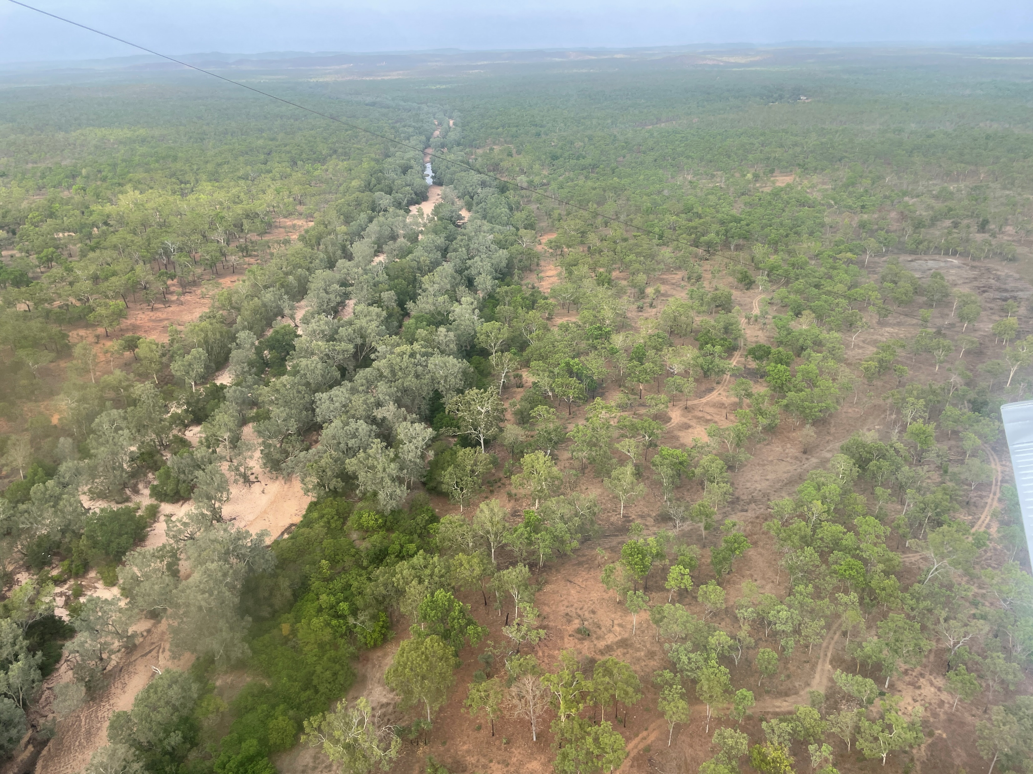
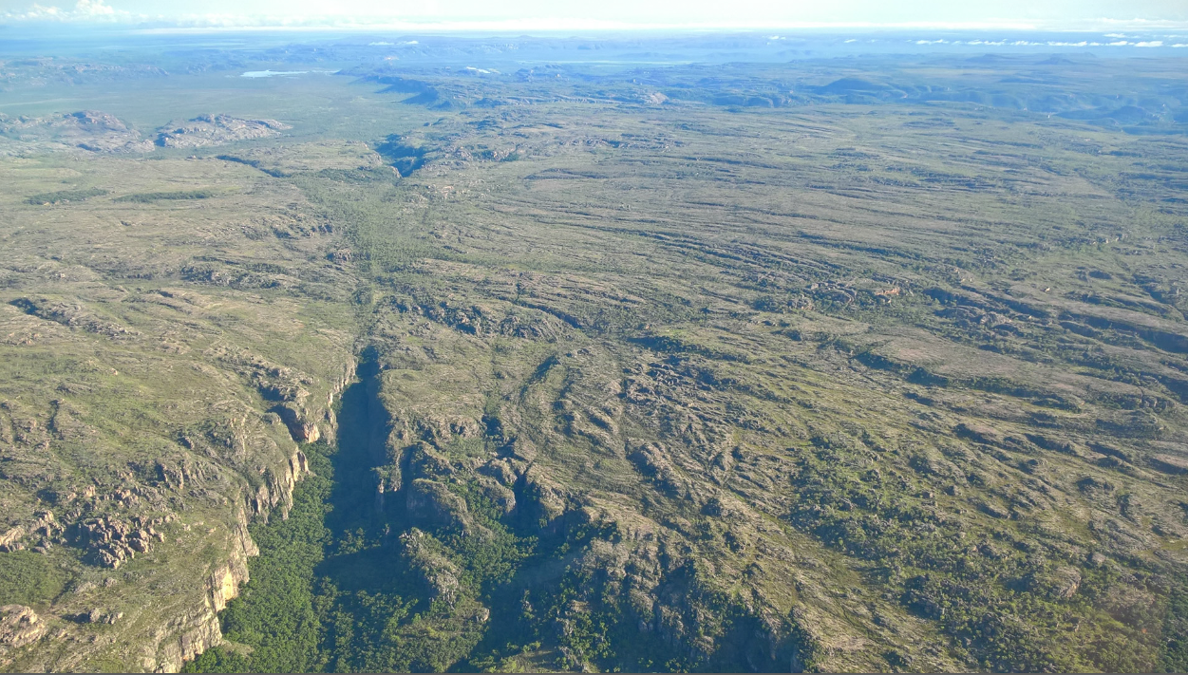
Acknowledgement of Country
Dean

Slide 3
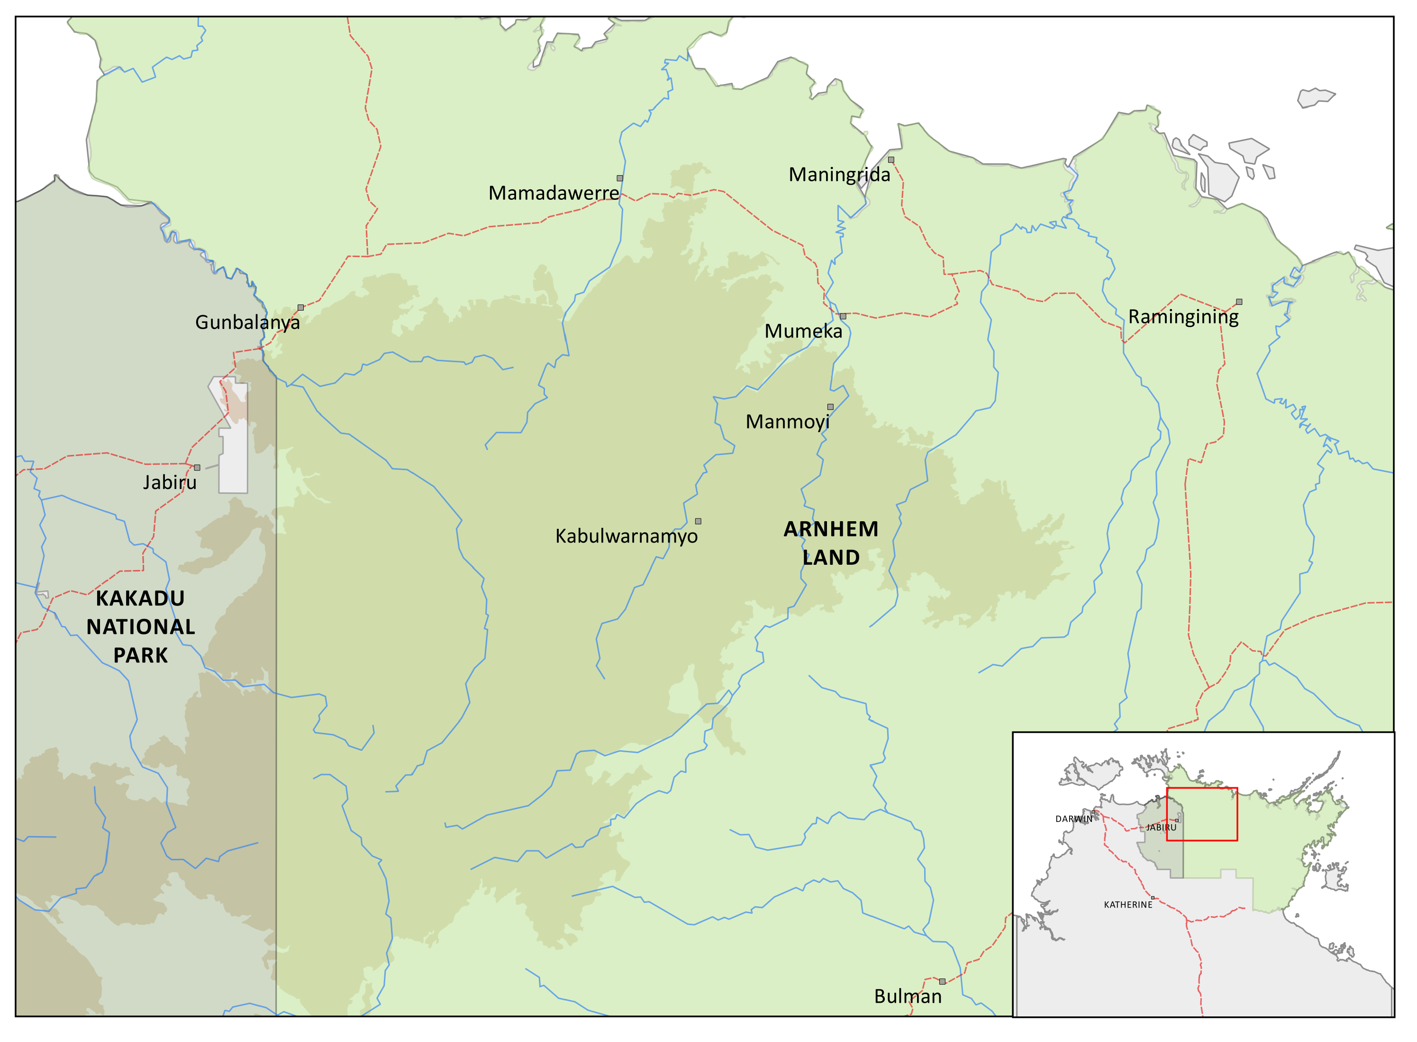
Context: map of Warddeken IPA
ABC news story link

Slide 4
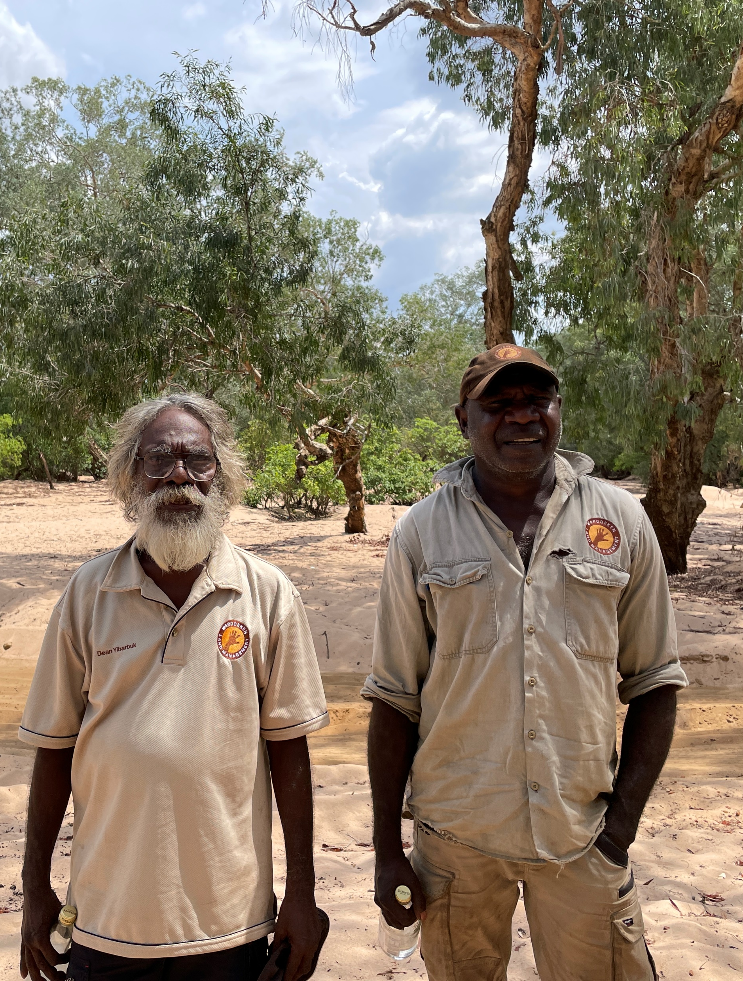
Evaluation of Nawarddeken Academy
AIMS
learn from and develop its governance, academic, and community engagement processes; and
to determine what the outcomes and values of its work are.
METHODOLOGICAL APPROACH AND FEATURES
Qualitative participatory action research, with cycles over 3 years
Indigenist standpoints
Community-based researchers
Working in and with language where possible

Slide 5
Key directions arising from data
Focusing on Kunwinjku literacy (reading and writing) as a priority, not just for children but for adults as well
Identifying and recruiting more Bininj (assistant) teachers
Creating training (professional learning) pathways for existing Bininj staff based on an assessment of current skills.
Supporting Balanda teachers with their learning of Bininj culture and language
Ensuring that Bininj histories and stories are reflected in the ongoing development of the Academy
Making the connection between what happens at school and work that happens on country clearer.

Slide 6
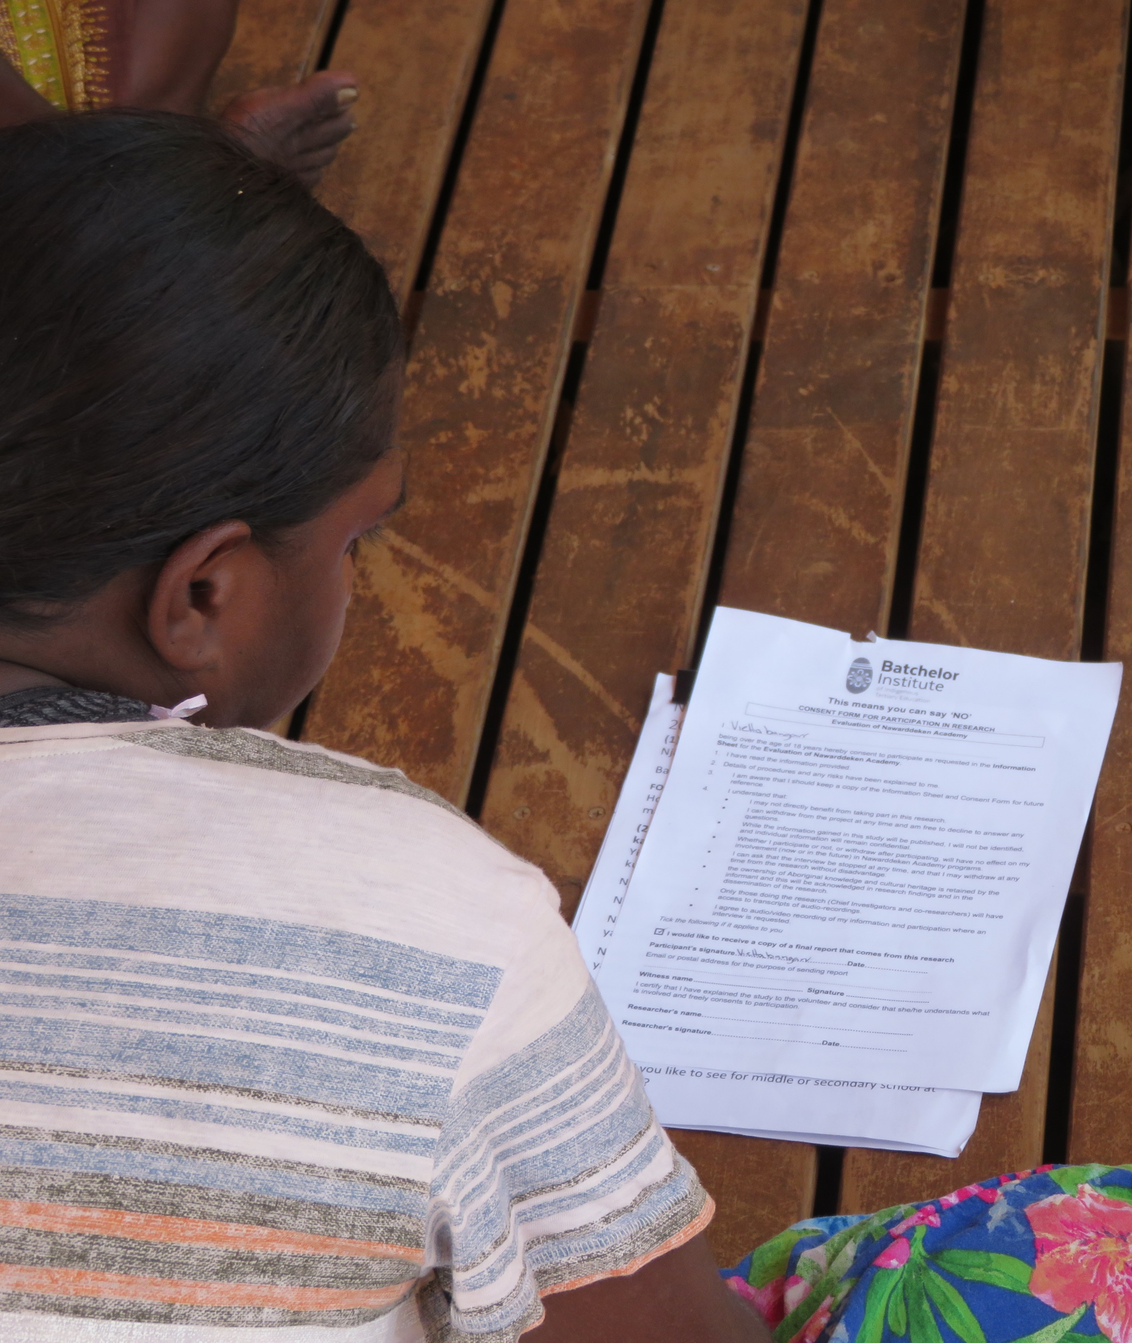
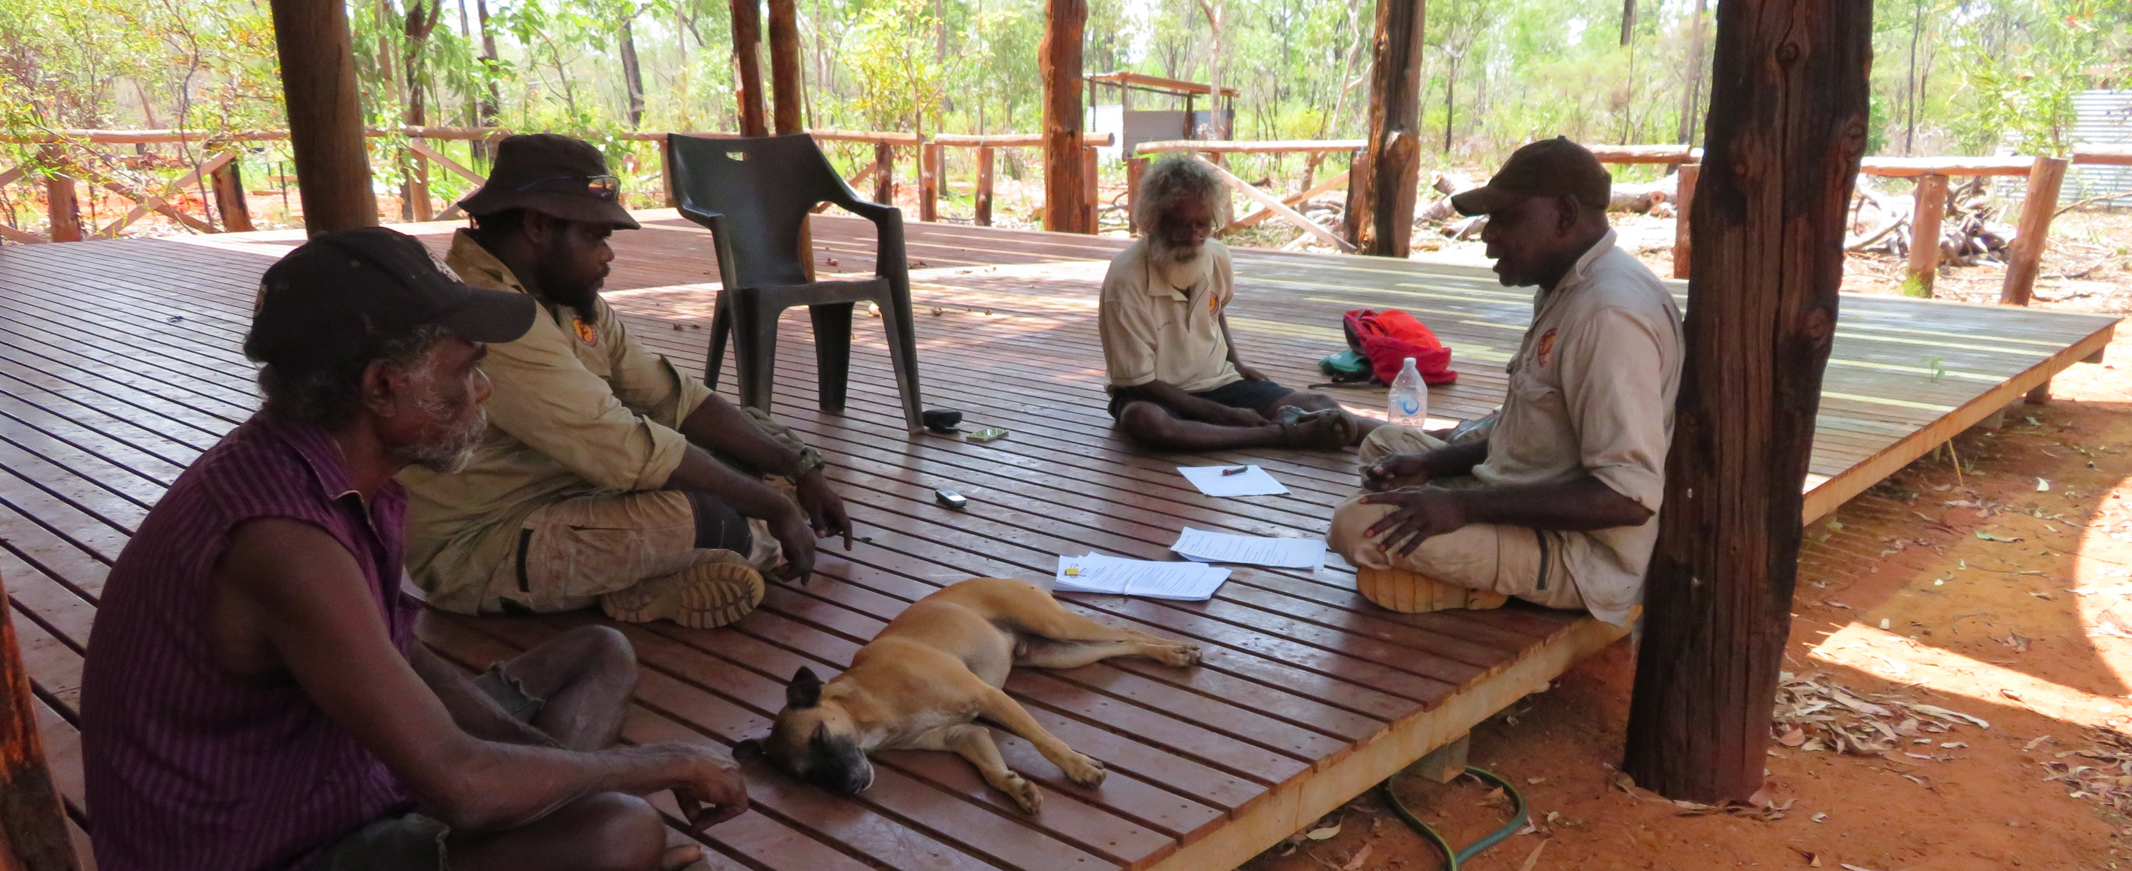
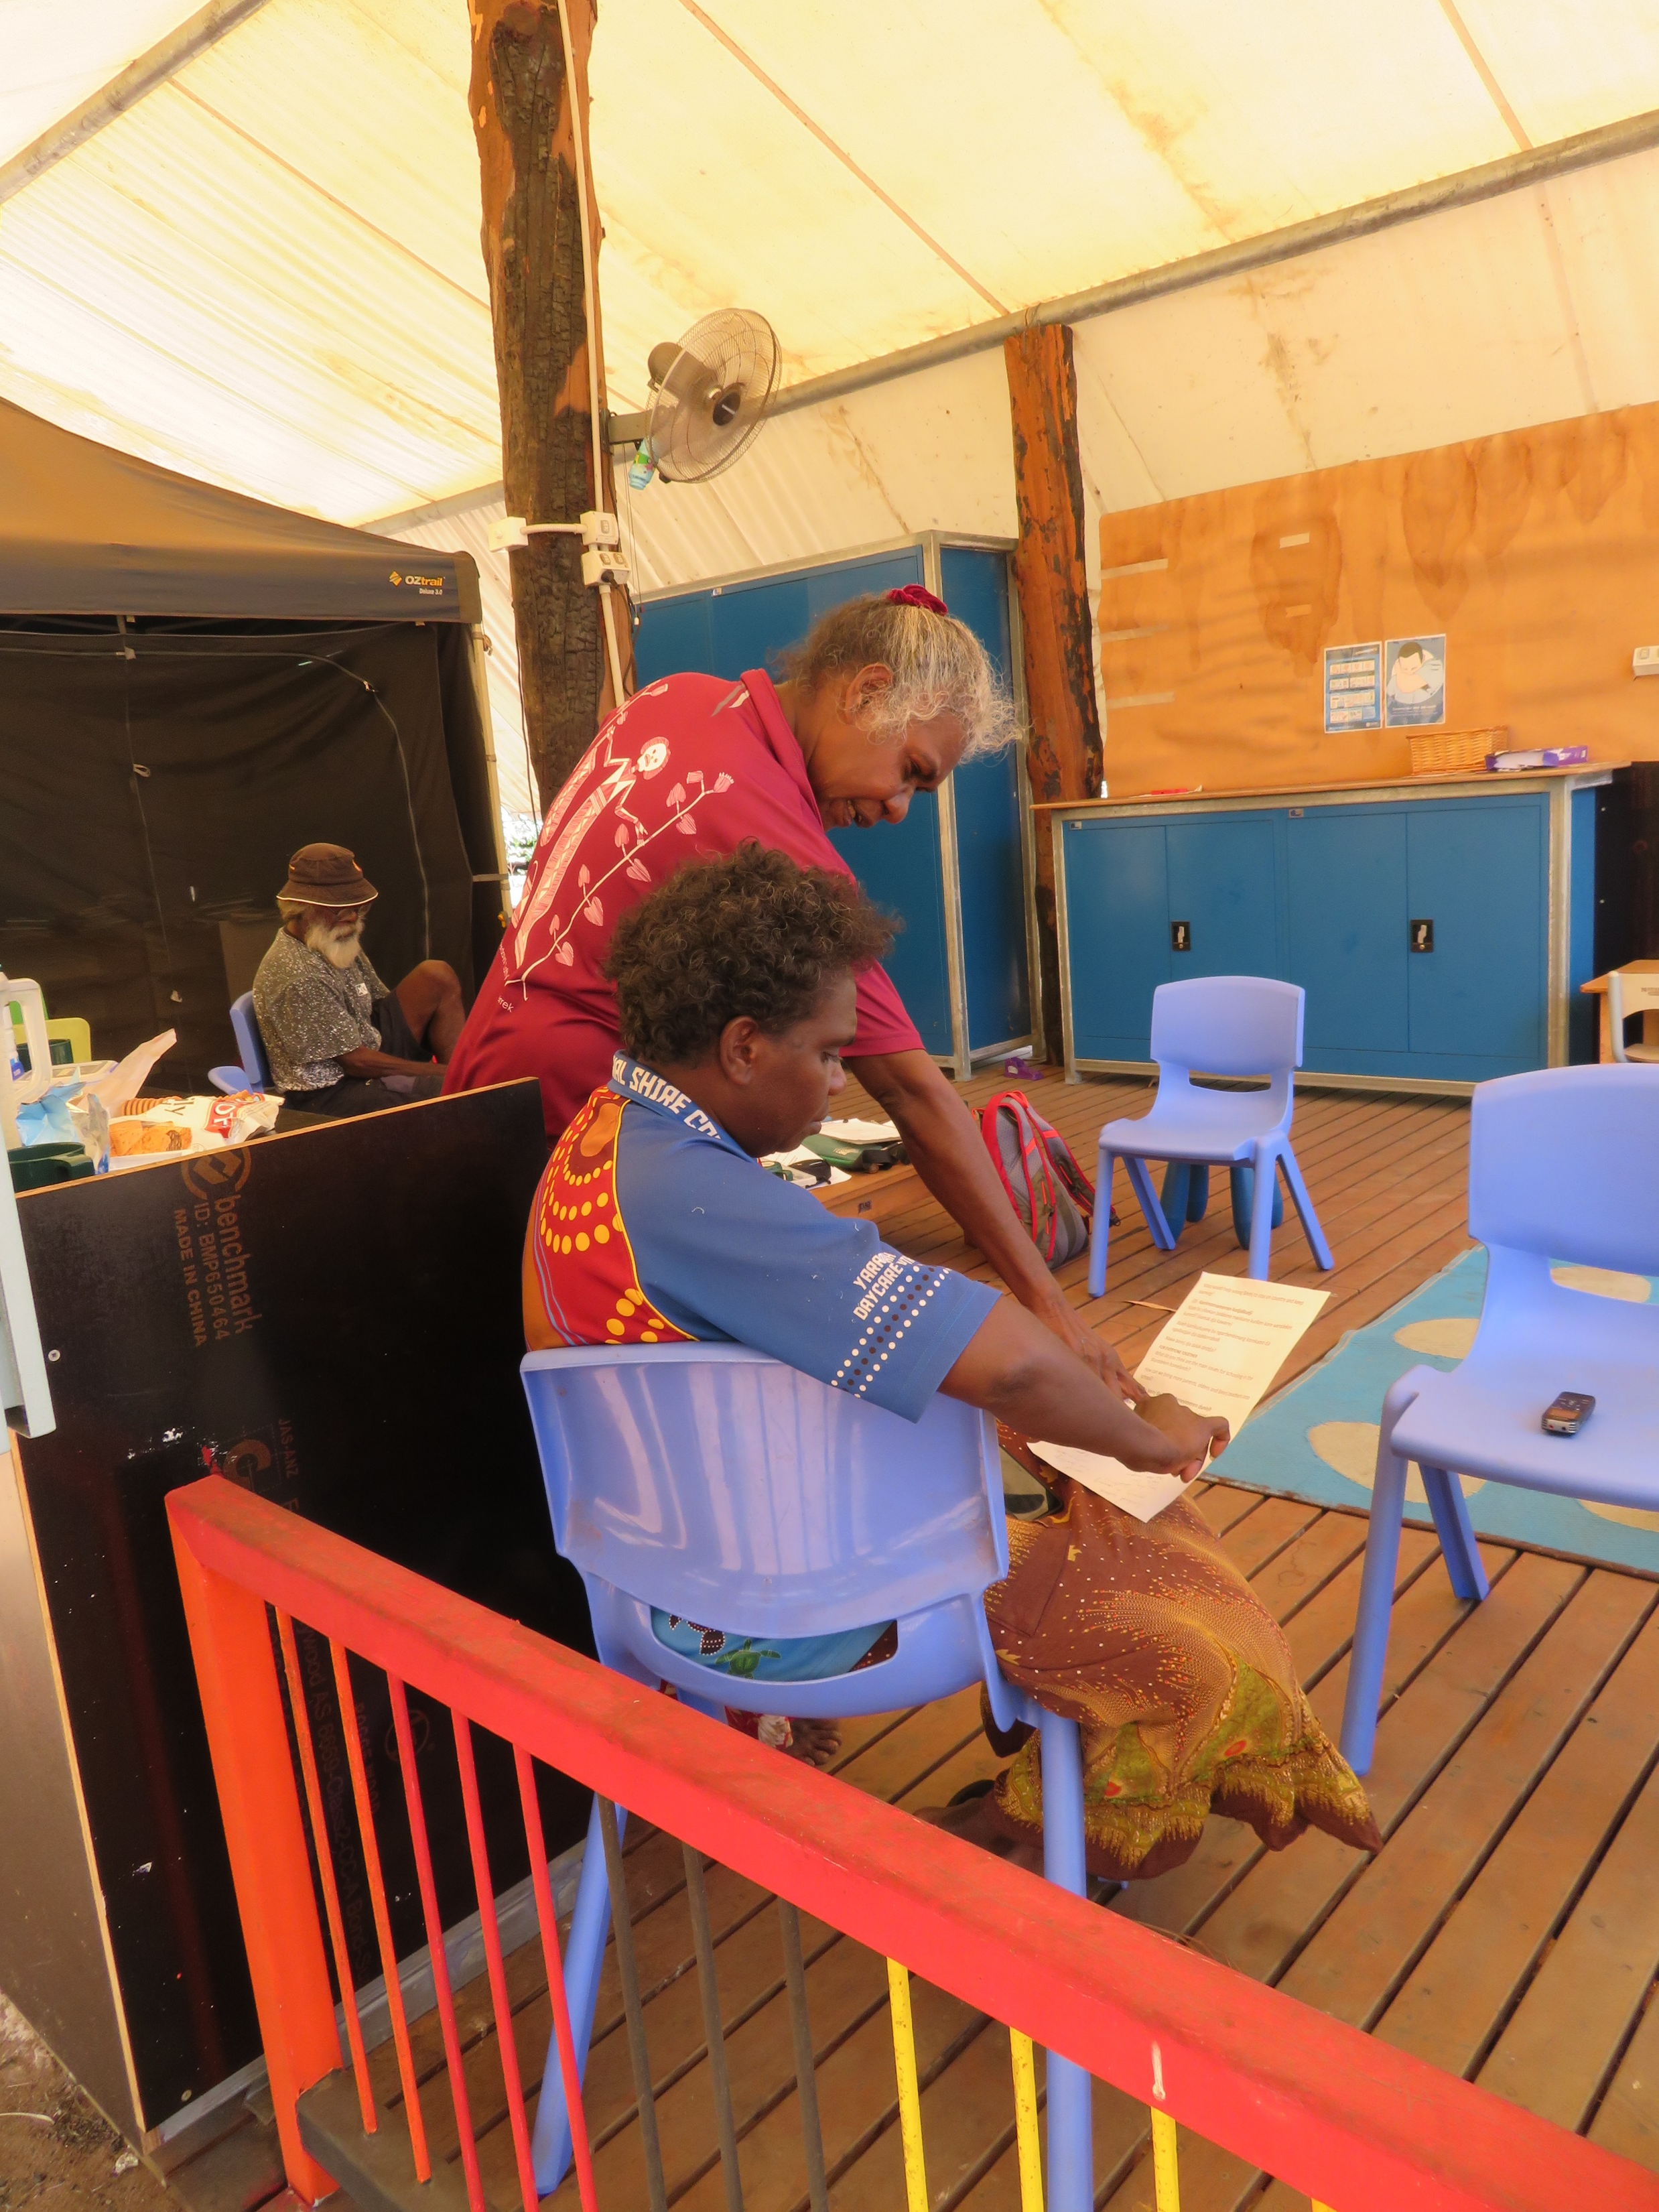
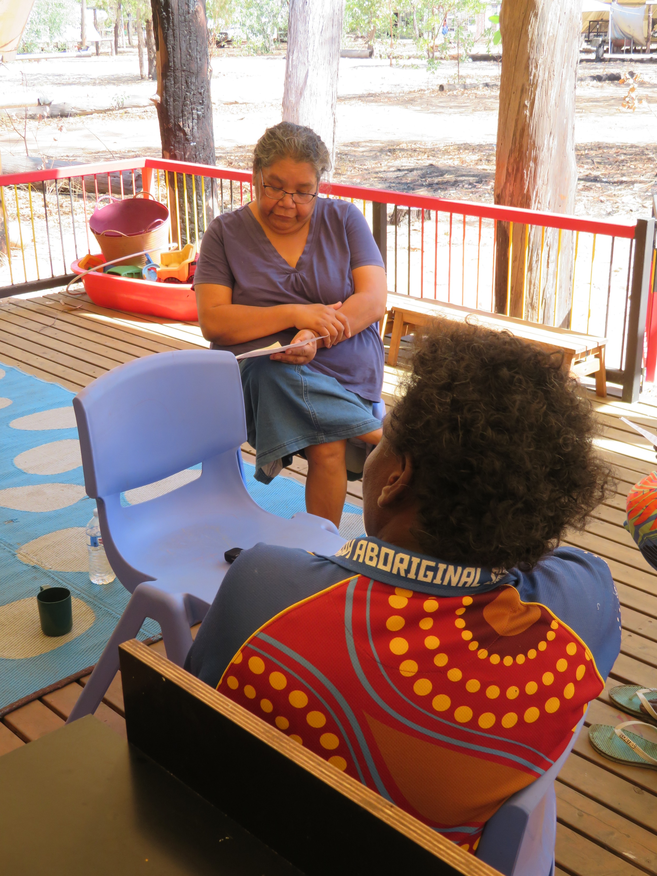
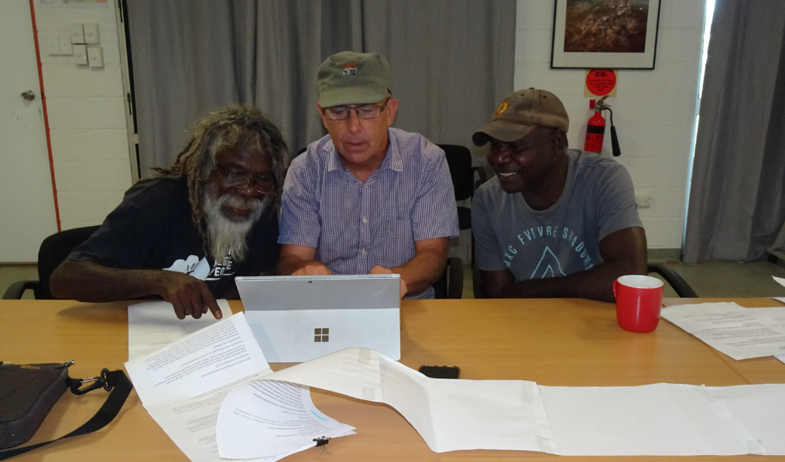
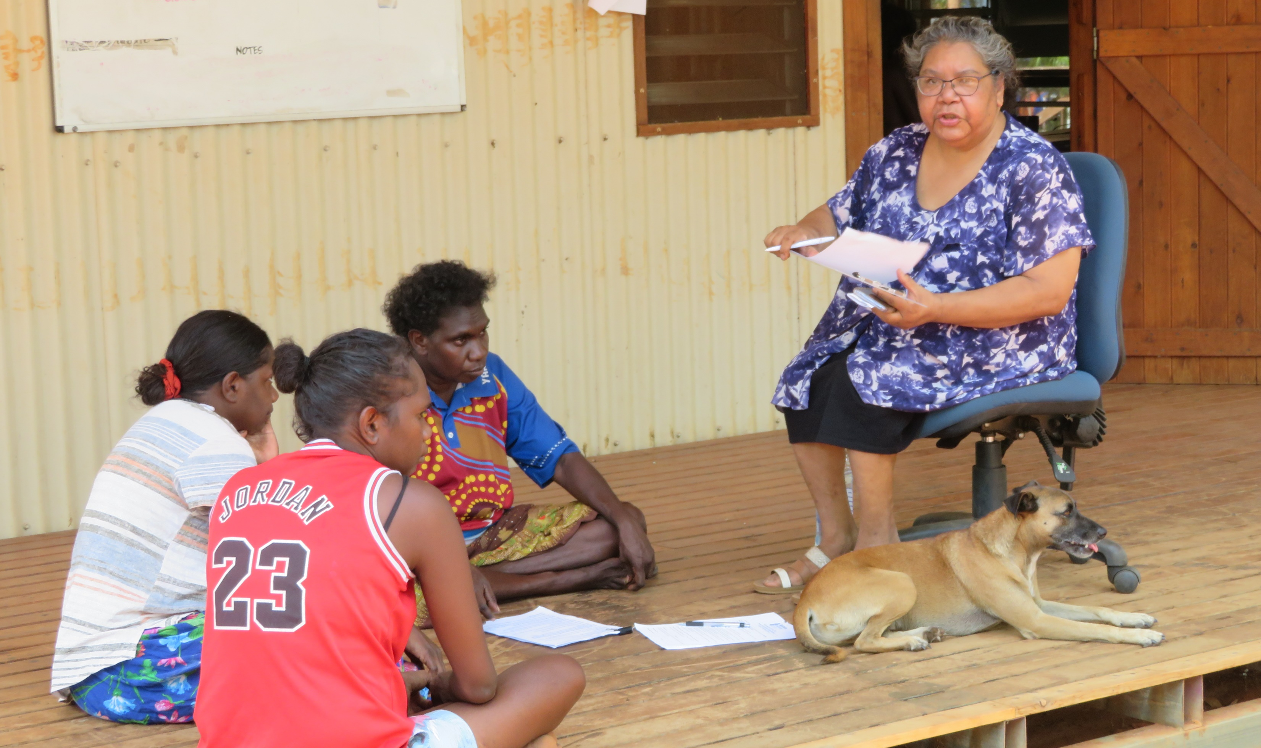
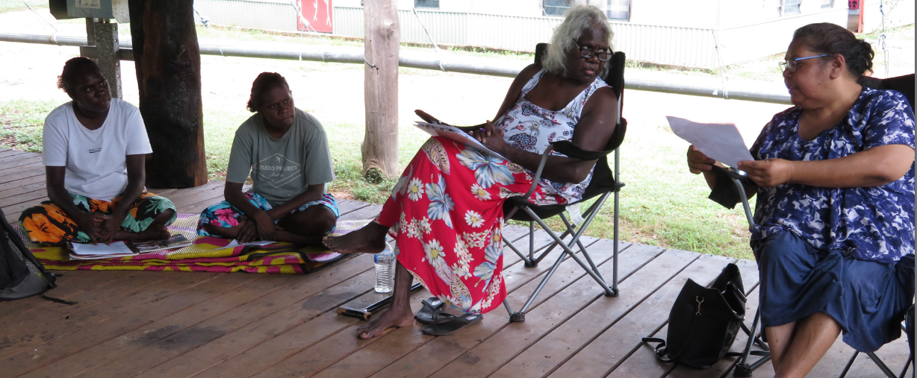
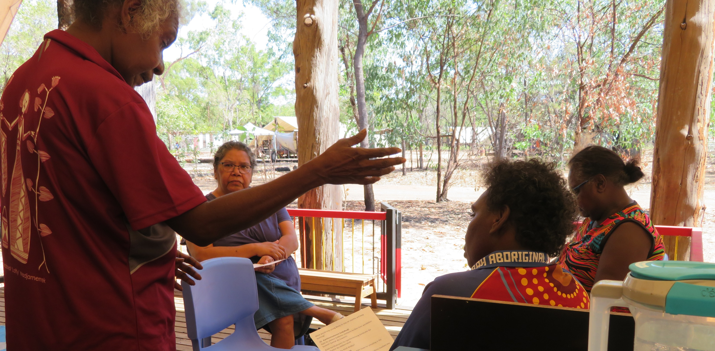
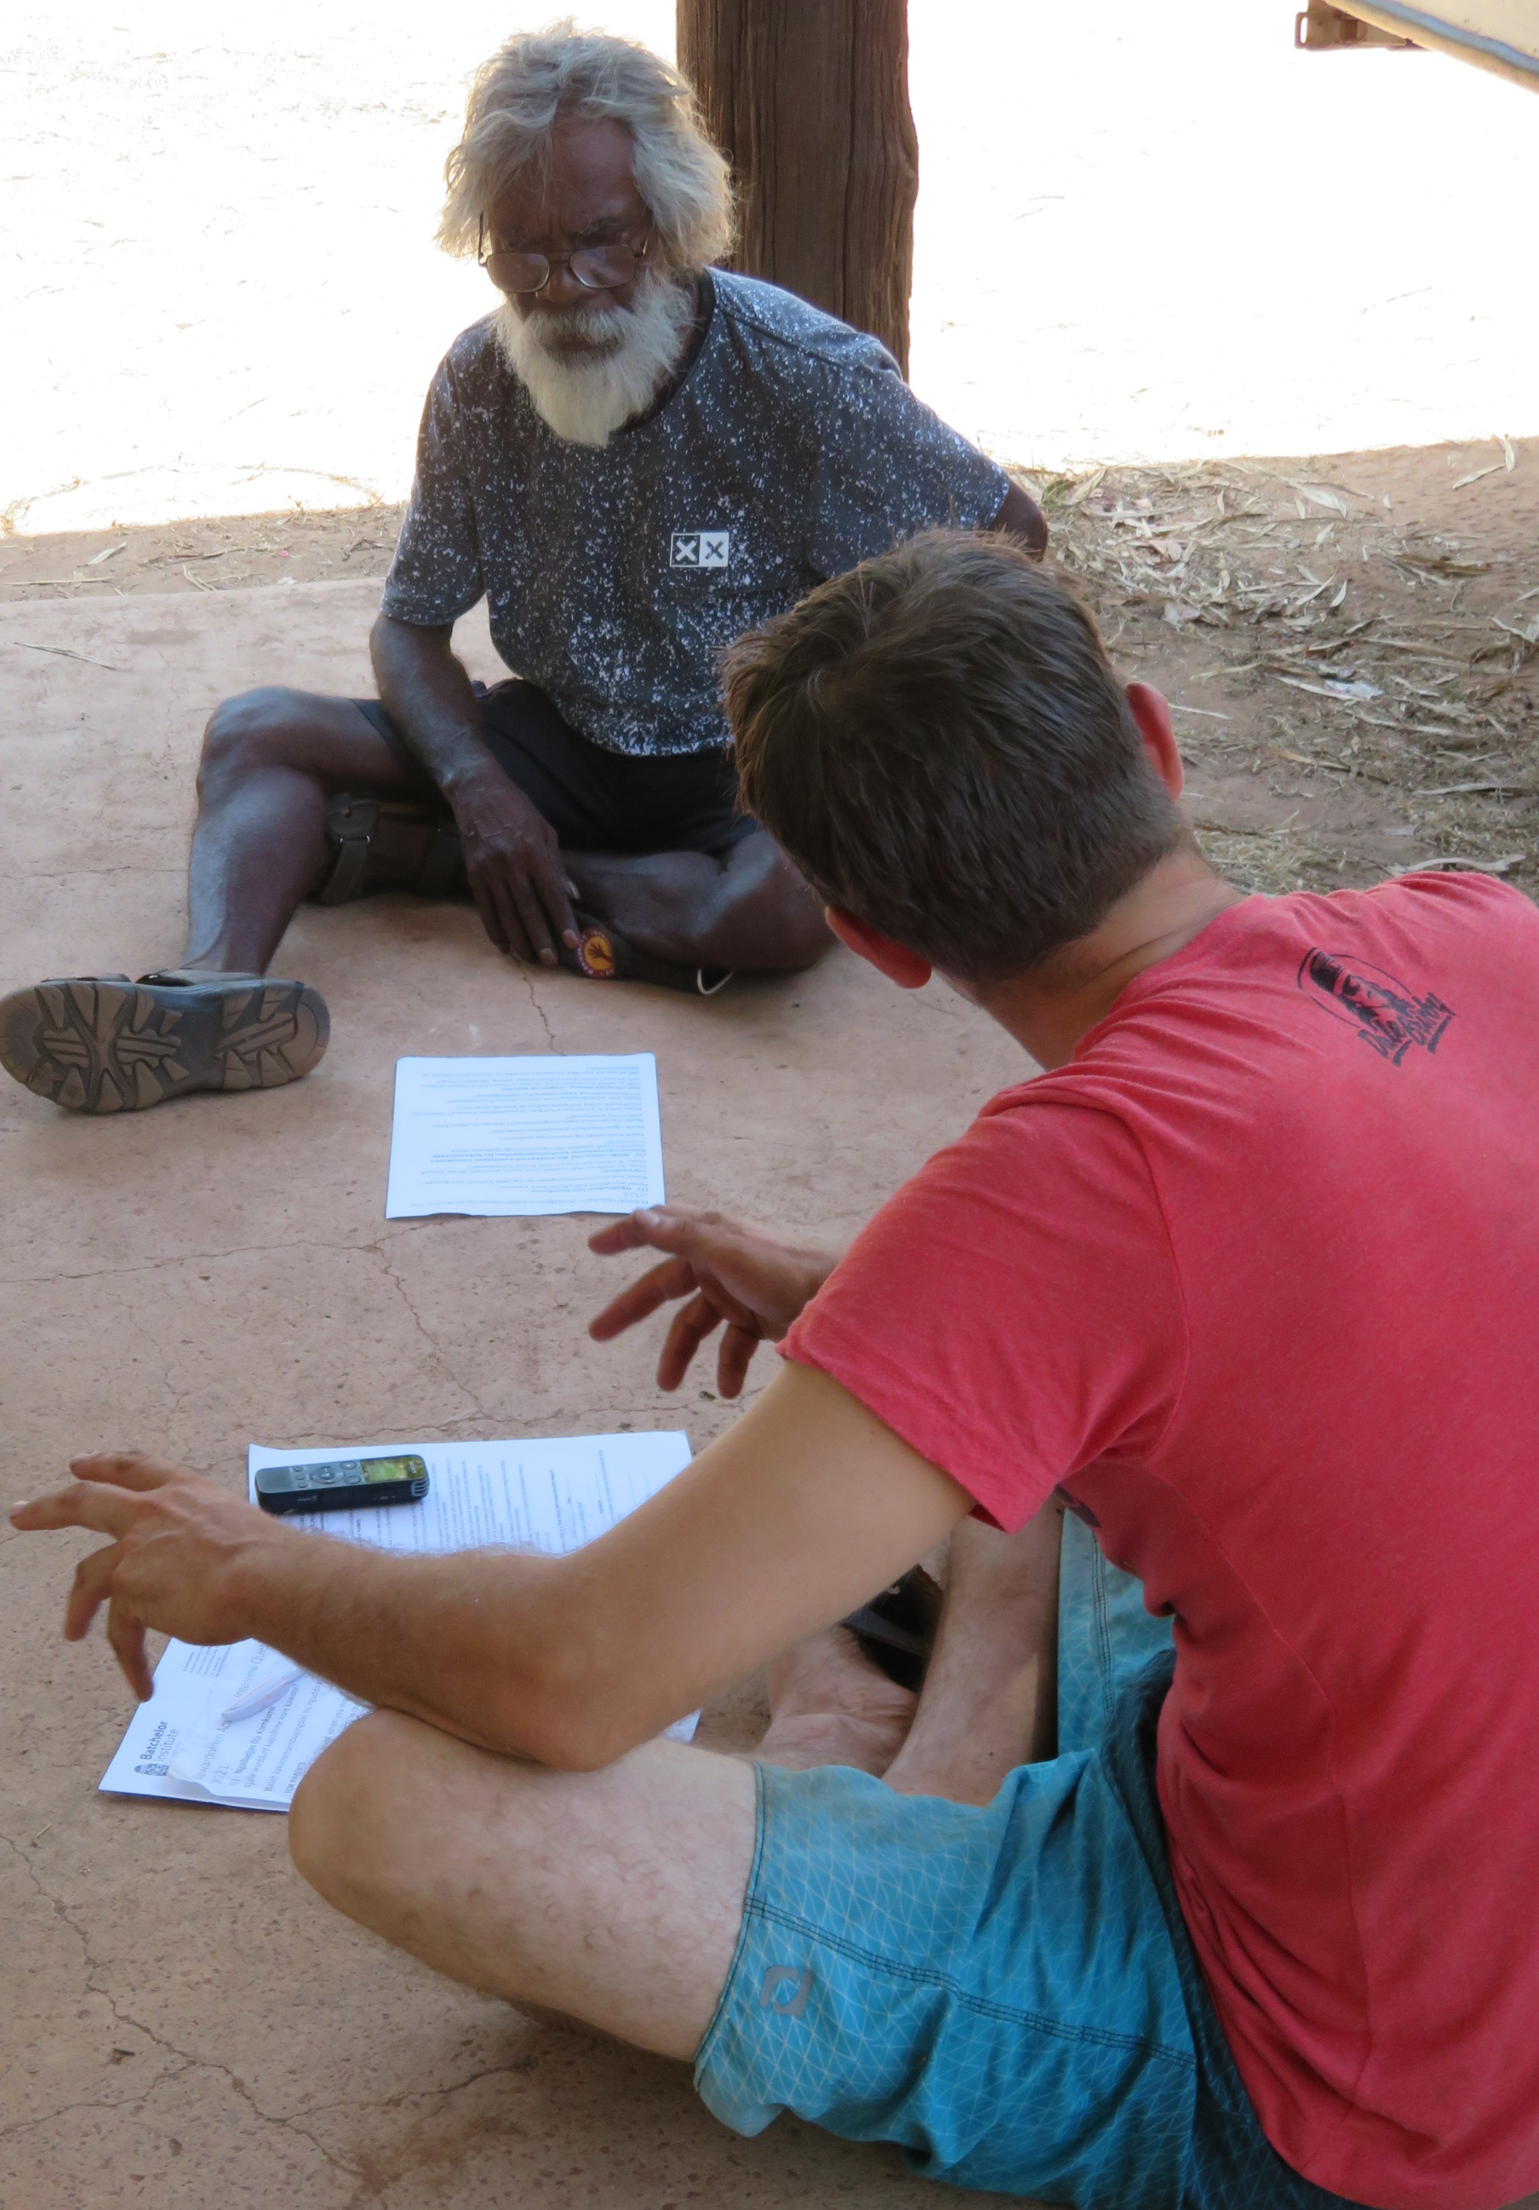
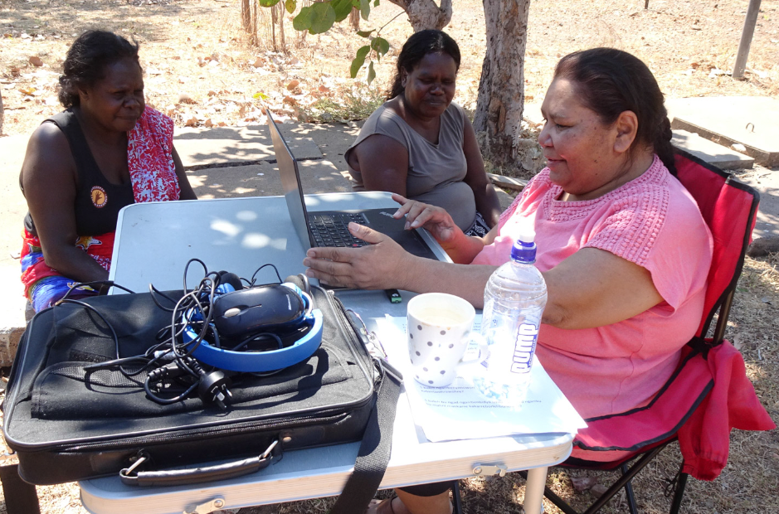
Stories from community researchers

Slide 7
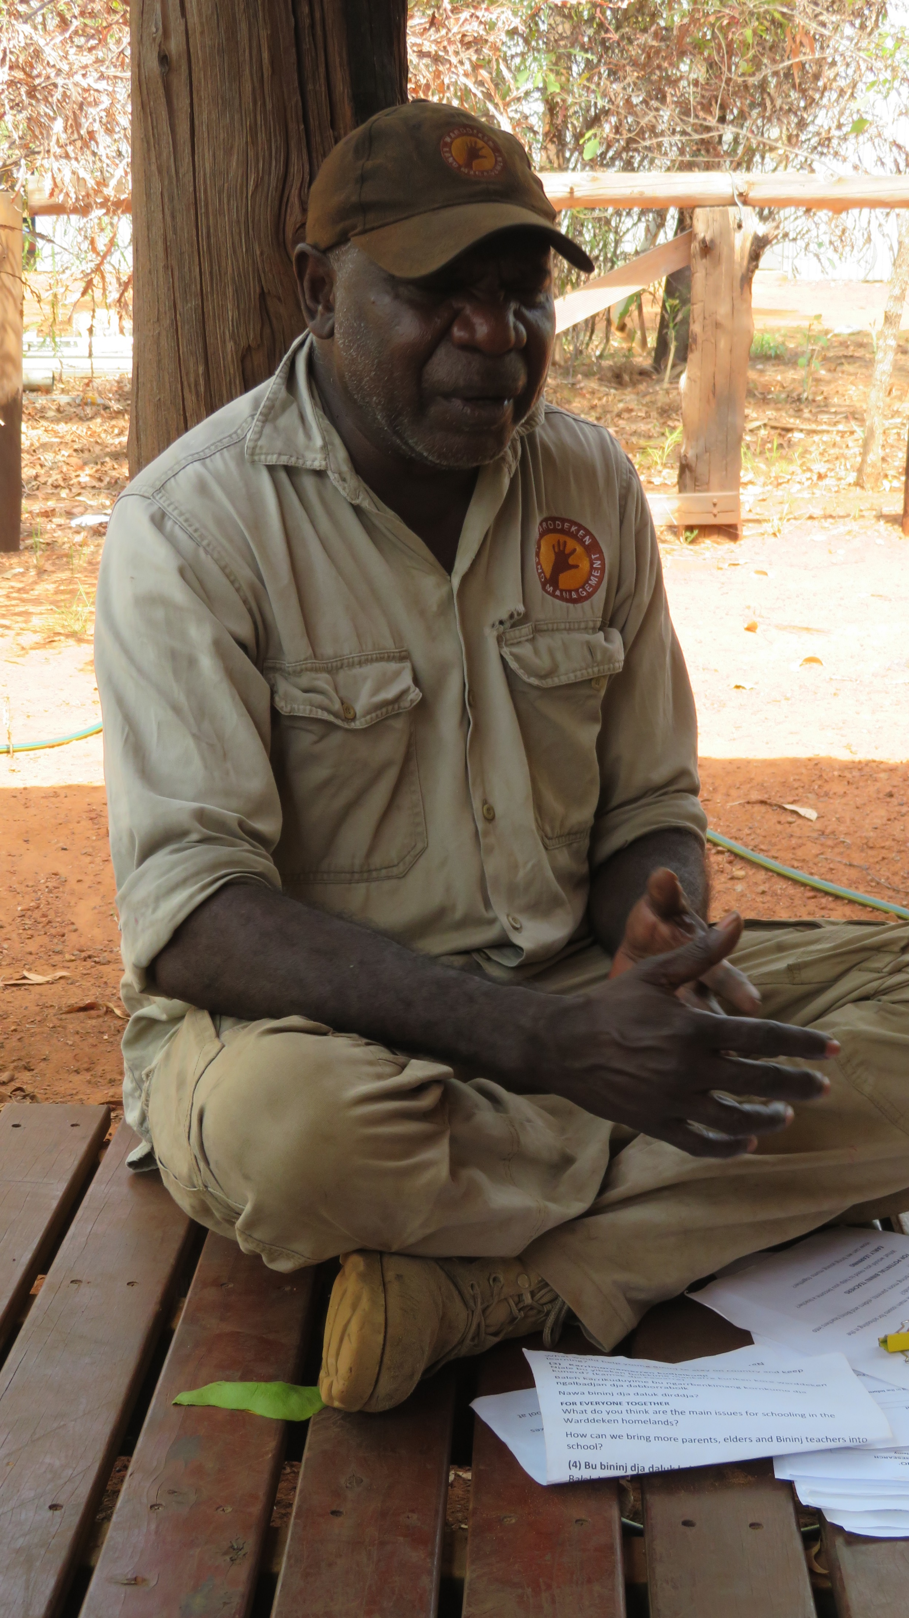
Key messages
Research has been around for a long time (kanekarremarnbun) process of working together to solve problems
External researchers don’t know protocols
Bininj researchers are on the ground and work with Bininj in language
Important to work with external researchers to talk with right people (two-way)
Gives Bininj voice
Future researchers, skills for future

Slide 8
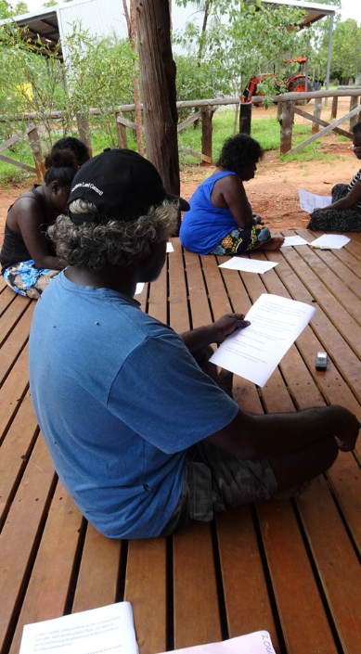

Contacts
Olga Scholes
olga.scholes@nawarddeken.org.au
0427 816 431
Robyn Ober
robyn.ober@batchelor.edu.au
08 8946 6246
Nawarddeken Academy

